Slide 3
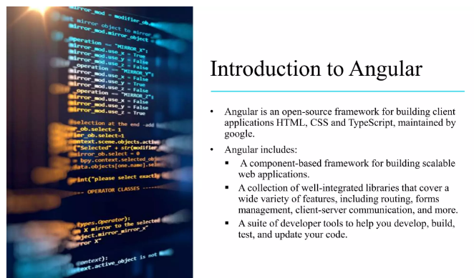

Slide 4
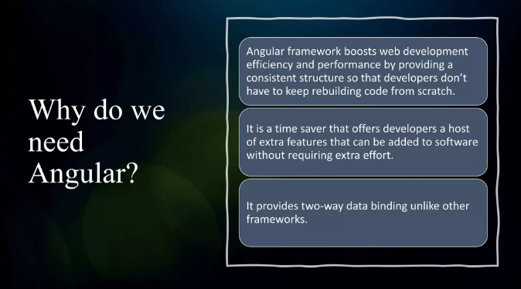

Slide 5
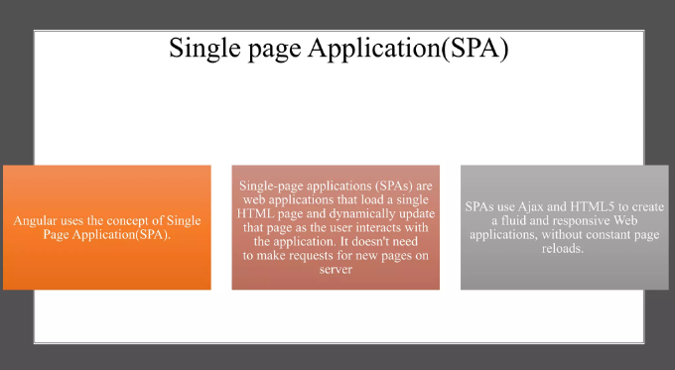

Slide 6
Reference: https://www.ngdevelop.tech/angular/history/

Slide 7
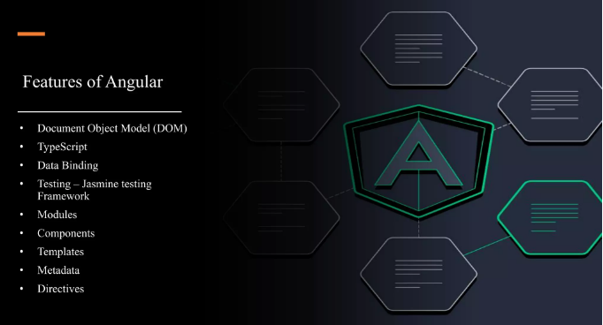

Slide 8
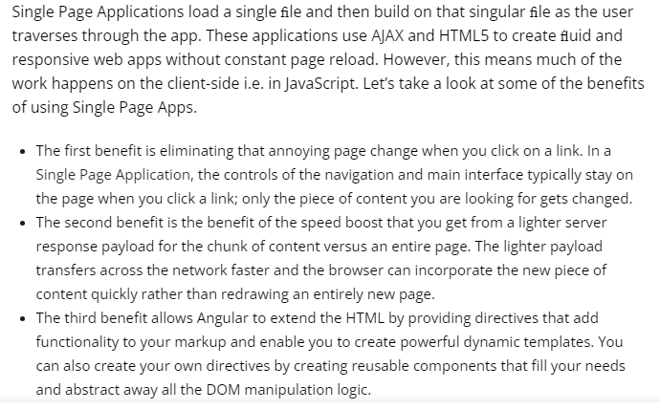
User Experience similar to a Desktop Application

Slide 9


Productivity and Tooling

Slide 10


Performance

Slide 11



Community
References:
https://angular.io/resources?category=community,
https://dev.to/t/angular,

Slide 12


Slide 13
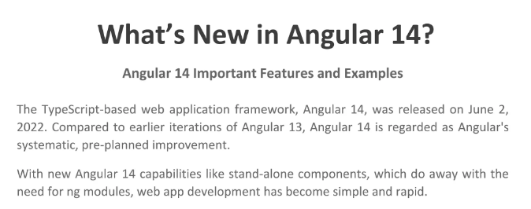

Slide 14
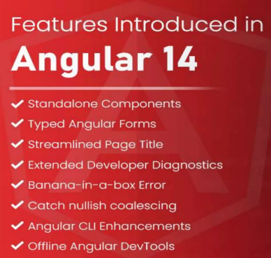

Slide 15
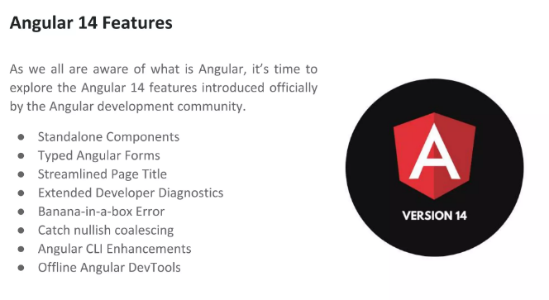
Clone From GitHub: https://github.com/savanihd/angular-14-crud-app

Slide 16
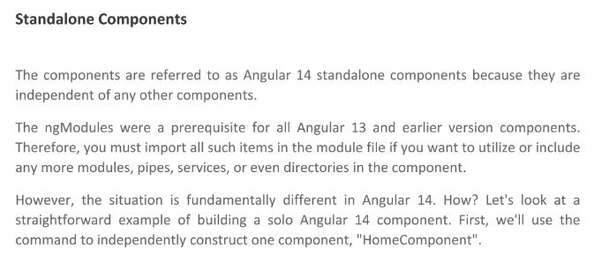
Reference: https://angular.io/guide/standalone-components

Slide 17
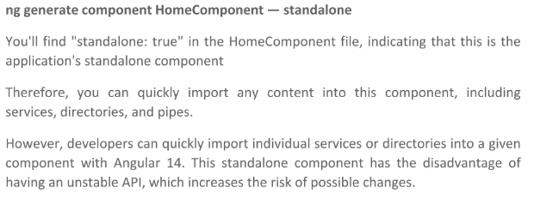

Slide 18
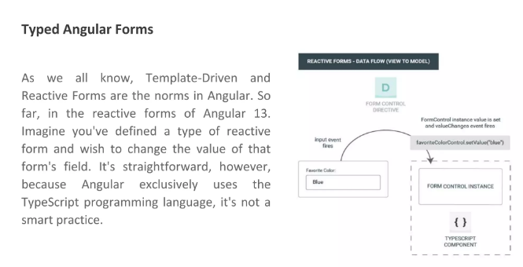
Reference: https://angular.io/guide/typed-forms

Slide 19
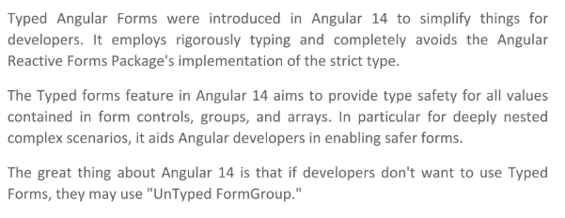

Slide 20
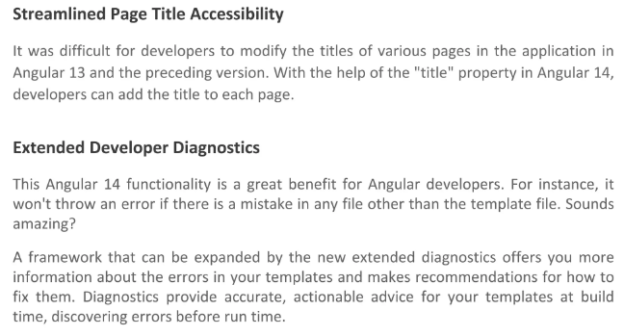

Slide 21
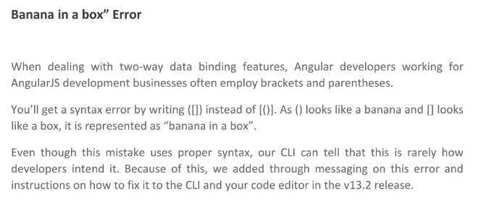

Slide 22
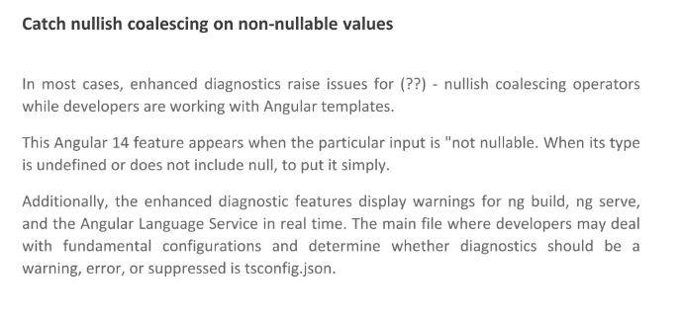
Reference: https://angular.io/extended-diagnostics/NG8102

Slide 23
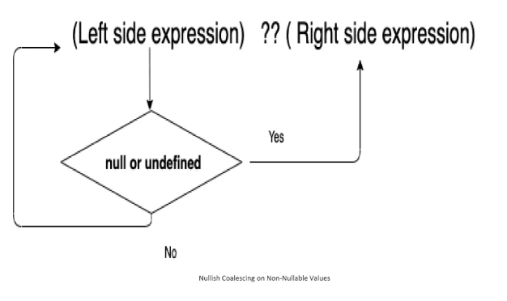

Slide 24
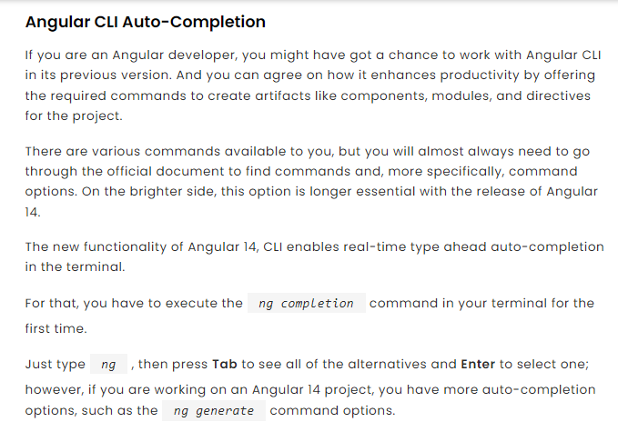

Slide 25


Slide 26
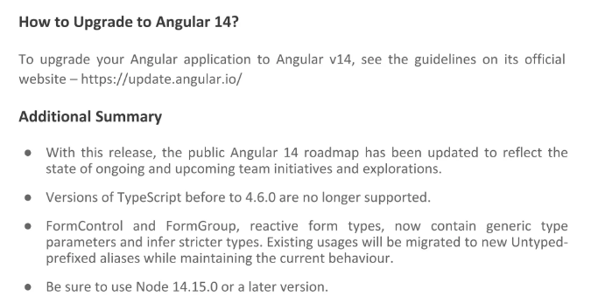

Slide 27
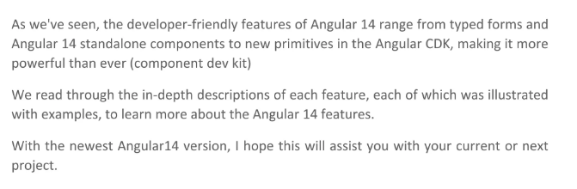

Slide 28
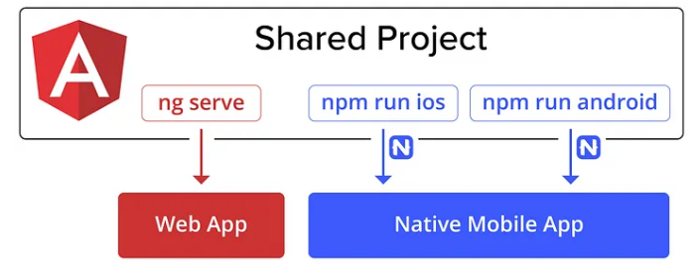
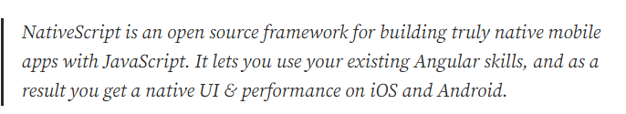
Reference: https://docs.nativescript.org/tutorial/angular.html

Slide 29
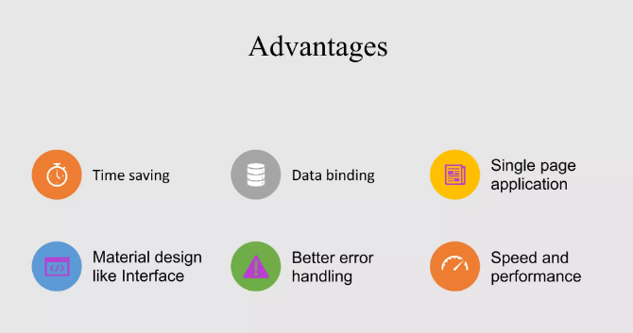

Slide 30


Slide 31


